Slide 1
Object Oriented Metrics
Impact on Software Quality

Slide 2
Classic metrics
Lines Of Code
Function points
Complexity
Code coverage - testing
Maintainability Index – discussed later

Slide 3
Lines of Code
Physical
KLOC = 1000 Lines Of Code
Function points = measure of develop. resources
Logical
Def: A line of code is any line of program text that is not a comment or blank line, regardless of the number of statements or fragments of statements on the line. This specifically includes all lines containing program headers, declarations, and executable and non-executable statements.
[Conte ao-Software Engineering Metrics and Models]
Number of external inputs x 4
Number of external outputs x 5
Number of logical internal files x 10
Number of external interface files x 7
Number of external inquiries x 4

Slide 4
Cyclomatic complexity
McCabe, 1976
CC = E - N + 2*P
Where:
E = number of edges in the flow graph
N = number of nodes in the flow graph
P = number of nodes that have exit points
Control flow graph: graph with:
nodes = basic blocks
edges correpsonding to all paths that may be traversed in a program during its execution

Slide 5
Object oriented (OO) metrics
Metrics - Chidamber & Kemerer – 1993
Available at:
http://maisqual.squoring.com/wiki/images/5/5c/Chid_kem_metrics.pdf
MOOD – Abreu – 1995
[Abreu, F. B. e., "The MOOD Metrics Set," presented at ECOOP '95 Workshop on Metrics, 1995.]

Slide 6
Classification
[Abreu]
5 aspects:
System
Coupling
Inheritance
Class
method

Slide 7
Classification
[Marinescu - Object-Oriented Software Metrics]
Available at: http://www2.informatik.hu-berlin.de/swt/intkoop/jcse/workshops/risan2007/0206-Marinescu-jcse-metrics.pdf
4 aspects:
Size & Structural Complexity
Inheritance
Coupling
Cohesion

Slide 8
Useful for:
Evaluate, predict, improve software quality
Detecting design flaws

Slide 9

Weighted Methods Per Class (WMC)
Definition: Consider a Class C1, with methods M1,... Mn that are defined in the class. Let c1,... cn be the complexity of the methods. Then :

Slide 10
Weighted Methods Per Class (WMC)
Indicator for how much time and effort is required to develop and maintain the class.
Higher values ⇒ higher impact on descendants
Higher values ⇒ more application specific, low reusability & maintainability
low values ⇒ greater polymorphism

Slide 11
Weighted Methods Per Class (WMC)
Criterion: ∈ [1, 50] or max 10% of classes may have WMC over 25
Remark: counts
Constructors and event handlers
Property accessor (Get, Set, Let)
Advice:
Refactor classes with high WMC
Impact: maintainability, reusability

Slide 12
Depth of Inheritance Tree (DIT)
Definition: maximum length from the node to the root of the tree.
measure of how many ancestor classes can potentially affect this class.

Slide 13
Depth of Inheritance Tree (DIT)
Higher DIT ⇒ higher complexity + difficult to predict behavior + difficult to maintain
But higher reusability
Values:
≤ 10
Rec. ≤ 5 (RefactorIT & Visual Studio)
In java min = 1
Advice:
If ≤ 2 then poor OO design
Not just per class, entire distribution

Slide 14
Number of children (NOC)
Definition: Number of immediate sub-classes subordinated to a class in the class hierarchy.
It is a measure of how many sub-classes are going to inherit the methods of the parent class.

Slide 15
Number of children (NOC)
high NOC ⇒
High reuse of base class
Base class may require more testing
Improper abstraction of the parent class
Misuse of sub-classing
+ high WMC ⇒ complexity at the top of the class hierarchy - poor design
Upper part of class hierarchy – higher NOC than lower part

Slide 16
Number of children (NOC)
Advice:
∈ [0,10] (RefactorIT)
≥ 10 => restructure class hierarchy

Slide 17
Coupling between Objects (CBO)
CBO(c) = | {d ∈ C − {c} | uses(c, d) or uses(d, c)}|
CBO′(c)=|{d ∈ C−({c} ∪ Ancestors(c))|uses(c, d) or uses(d,c)}|
Where:
item C: an OO software system
Ancestors(c): generalizations of c
uses(c, d) true if method (re)defined by d invoked by method of c

Slide 18
Coupling between Objects (CBO)
through method calls, field accesses, inheritance, arguments, return types, and exceptions
High CBO ⇒
Low modularity and reusability
(independent classes - easier to reuse)
Low maintainability
High complexity ⇒ difficult testing

Slide 19
Coupling between Objects (CBO)
Advice:
If high CBO and high NOC re-evaluate design
Used by senior designers and project managers to track
whether the class hierarchy is losing its integrity
whether different parts of a large system are developing unnecessary interconnections in inappropriate places.

Slide 20
Afferent Coupling (Ca)
determines the number of classes and interfaces from other packages that depend on classes in the analyzed package
indicator of the level of responsibility:
If the package is relatively abstract then a large number of incoming dependencies is acceptable and not if the package is more concrete.
Indicator of maintainability and testability

Slide 21
Efferent Coupling (Ce)
Determines the number of other packages that the classes in the package depend upon is an indicator of the package's independence.
High Ce:
package is unfocussed
unstable since it depends on the stability of all the types to which it is coupled.
max 20 (RefactorIT) recommends an upper limit of 20.
Advice: extract classes from the original class so the class is decomposed into smaller classes.

Slide 22
class Foo { Qclass q; } class Bar { Qclass q; } class Qclass { // ... }
Afferent Coupling
Efferent Coupling
measure of how many other classes use the specific class
measure of how many different classes are used by the specific class
Ce(Foo) = Ce(Bar) = 1
Ca(Qclass) = 2

Slide 23
Lack of Cohesion of Methods (LCOM)
LCOM1, LCOM2, LCOM3 and LCOM4 (Hitz & Montazeri)
Definition: Let C be a class
IC is the set of instance variables of C
MC is the set of methods of C
GC is a graph with
vertices V = MC and
edges E ⊂ (V × V) where (m, n) ∈ E ⇐⇒ m and n share at least one common instance variable
LCOM = number of connected subgraphs

Slide 24
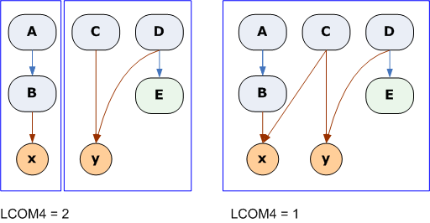
Lack of Cohesion of Methods (LCOM4)
Methods a and b are related if:
they both access the same class-level variable
a calls b, or b calls a.
LCOM4=1 - cohesive class =>"good" class
LCOM4>=2 – problem => split class into smaller classes
LCOM4=0 - no methods in a class => "bad" class
Notes:
The example on the left shows a class consisting of methods A through E and variables x and y. A calls B and B accesses x. Both C and D access y. D calls E, but E doesn't access any variables. This class consists of 2 unrelated components (LCOM4=2). You could split it as {A, B, x} and {C, D, E, y}.
In the example on the right, we made C access x to increase cohesion. Now the class consists of a single component (LCOM4=1). It is a cohesive class.

Slide 25
Lack of Cohesion of Methods (LCOM4)
Cohesiveness promotes encapsulation
Lack of cohesion - split into two or more sub-classes
Any measure of disparateness of methods helps identify flaws in the design of classes
Low cohesion increases complexity and maintainability

Slide 26
TCC (Tight Class Cohesion)
measures the cohesion of a class: the relative number of method-pairs that access an attribute of the class
Example: TCC = 2/10, resp. 4/10
TCC ∈[0..1]
Higher TCC => higher cohesion
LCC – Loose Class Cohesion

Slide 27
MOOD and MOOD2 metrics [F. Brito & Abreu]
MHF - Method Hiding Factor
AHF - Attribute Hiding Factor
MIF - Method Inheritance Factor
AIF - Attribute Inheritance Factor
PF - Polymorphism Factor
CF - Coupling Factor
MOOD2 – extension of MOOD

Slide 28
Law of Demeter
proposed at Northeastern University in 1987
Form of loose coupling
Summary:
Each unit should have only limited knowledge about other units: only units "closely" related to the current unit.
Each unit should only talk to its friends; don't talk to strangers.
Only talk to your immediate friends.
"Only talk to your friends" => "Only talk to your friends who share your concerns"

Slide 29
Law of Demeter
Objects should only collaborate with their nearest neighbours - the less they depend on the interfaces of “friends of a friend”, the less reasons they might have to have to change
avoiding long navigations and deferring knowledge of interactions with objects that aren’t directly related to your nearest neighbours

Slide 30
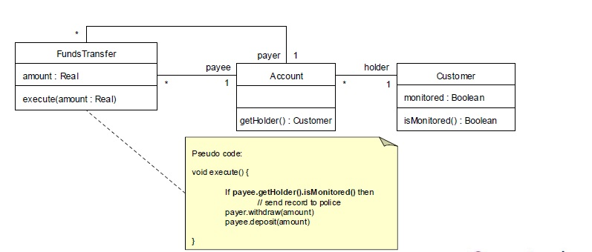
Law of Demeter
Refactor

Slide 31
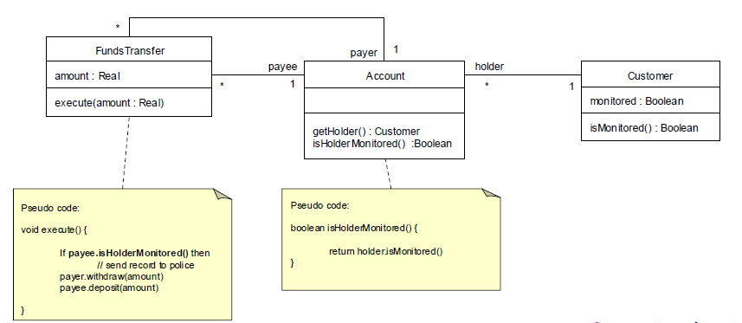
Law of Demeter

Slide 32
Law of Demeter
Talk by Ben Orenstein at RailsConf 2013 provides a very good visualization of the Law of Demeter
http://www.youtube.com/watch?v=l9JXH7JPjR4
Further reading: D.Bock - The Paperboy, The Wallet, and The Law Of Demeter

Slide 33
OO metrics Tools
Metrics plugin Eclipse
IntelliJ MetricsReloaded plugin – Java
SourceMeter – Java, Python, C#, C++
Ndepend + Metrics - .NET
PhpMetrics

